Slide 1
Apriori algorithm

Slide 2
Data set
TID | Item Bought
1 | {Bread, Butter, Milk}
2 | {Bread, Butter}
3 | {Beer, Cookies, Diapers}
4 | {Milk, Diapers, Bread, Butter}
5 | {Beer, Diapers}
For the Given dataset, apply Apriori algorithm to discover strong association rules.
Assume that min_support=40% and min_confidence = 70%
General association rules from the frequent itemset. Calculate the confidence of each rule and identify all the strong association rules.

Slide 3
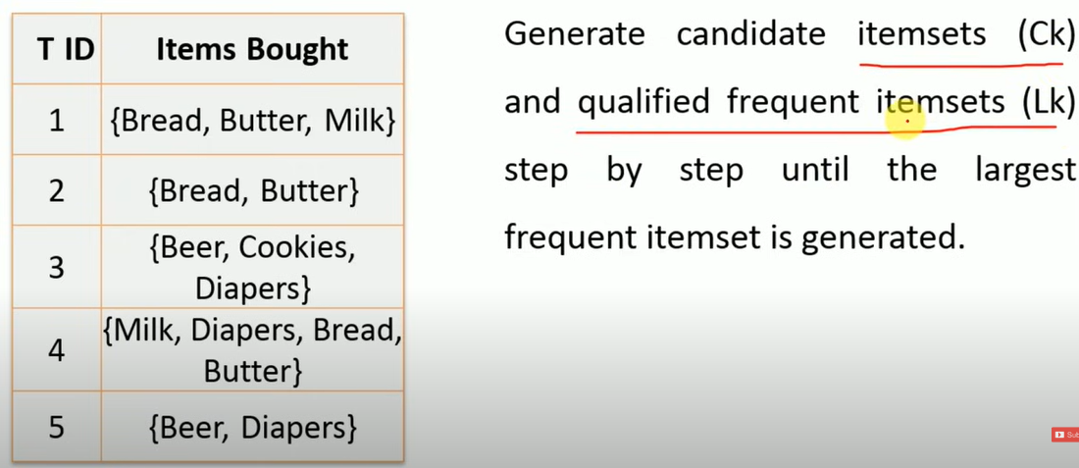
Step 1

Slide 4
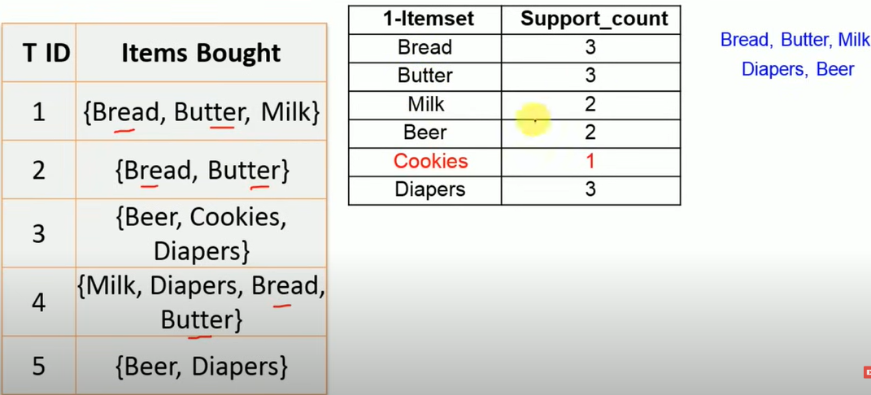
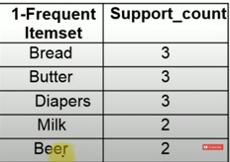
Five unique products
1-Frequent item set
Min_support = 40%
Min_support_count
=min_support * itemset_count
=40% * 5 =2

Slide 5
2-itemset
Create 2-itemset combinations from
Bread, Butter, Diapers, Milk, Beer

Slide 6
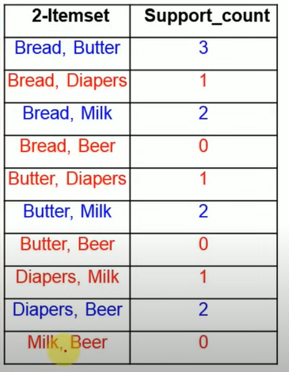
2-itemset combinations (Bread, Butter, Diapers, Milk, Beer) and find how many times each combination occurred in dataset.

Slide 7
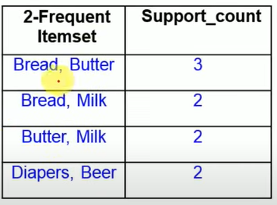
2-Frequent itemset

Slide 8
3-itemset
In previous table unique items ( Bread, Butter, Milk, Diapers, Beer)
Now make three combinations

Slide 9
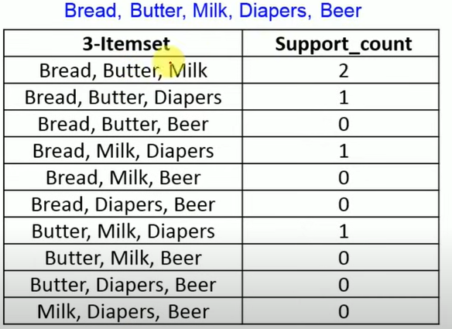
3-itemset and how many times each combination occurred in dataset
Now select 3-frequent itemset which satisfy the minimum support_count of 2.

Slide 10
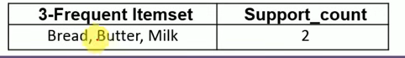
3-Frequent Itemset
Can we proceed with 4 frequent itemset ? No
So we stop here and we write association rules

Slide 11
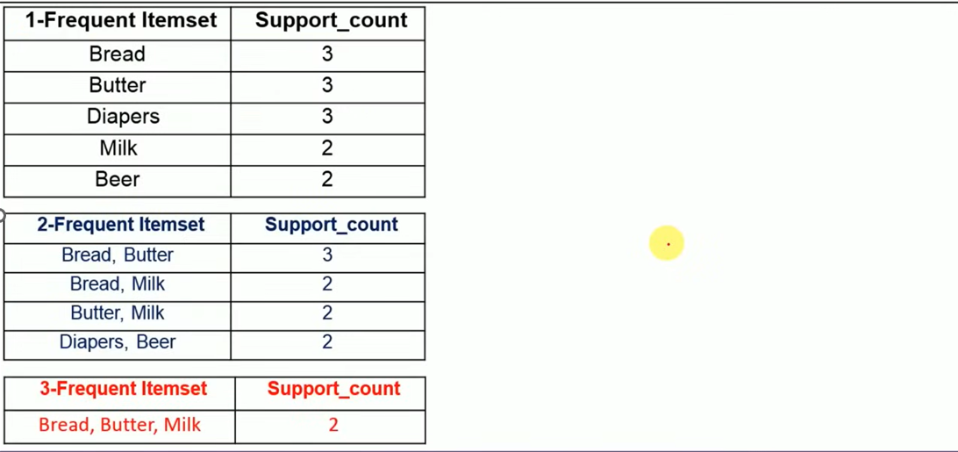
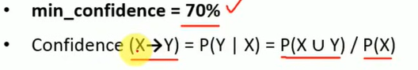
Three Frequent Itemset tables
If you wan to calculate confidence of a particular rule e.g. X tends to Y :
number of times both items bought together divided by the first item bought

Slide 12
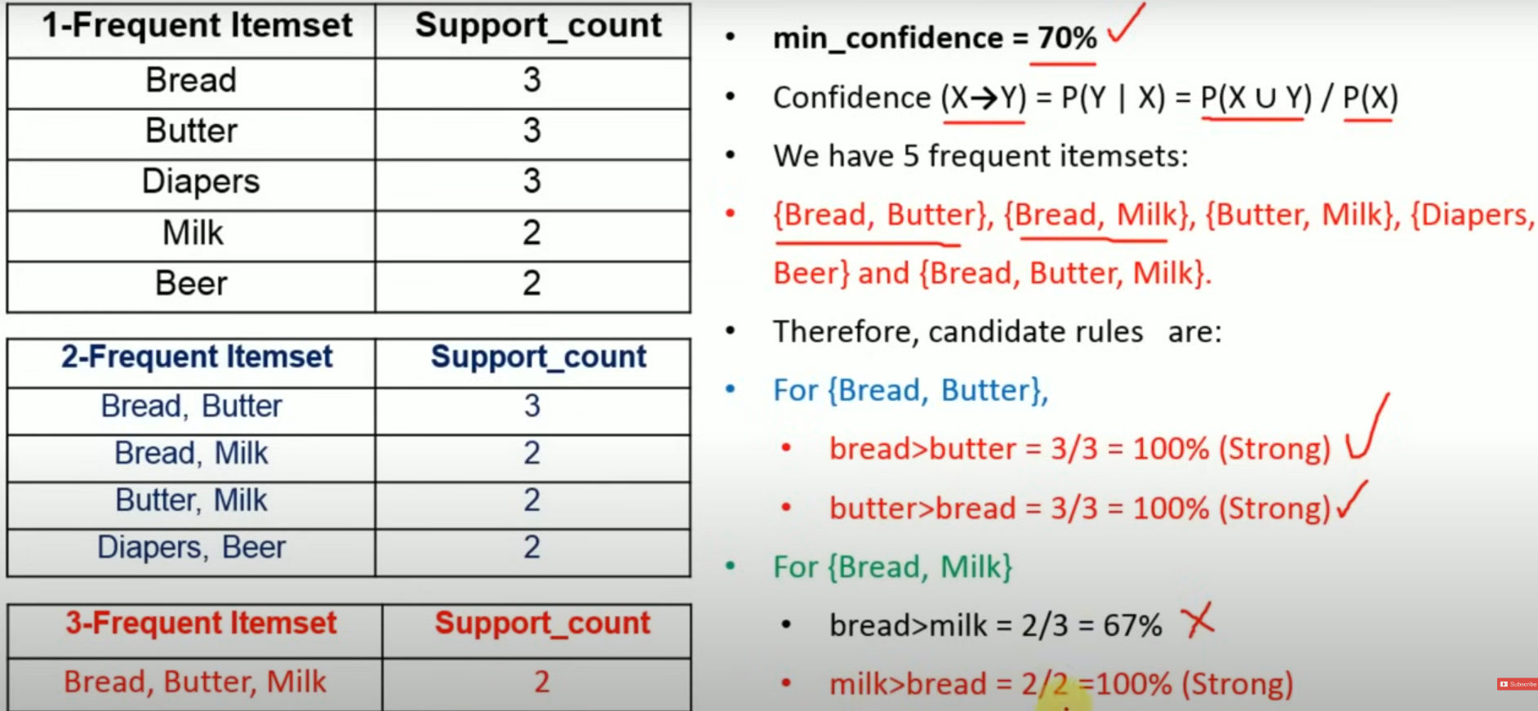
Association rules

Slide 13
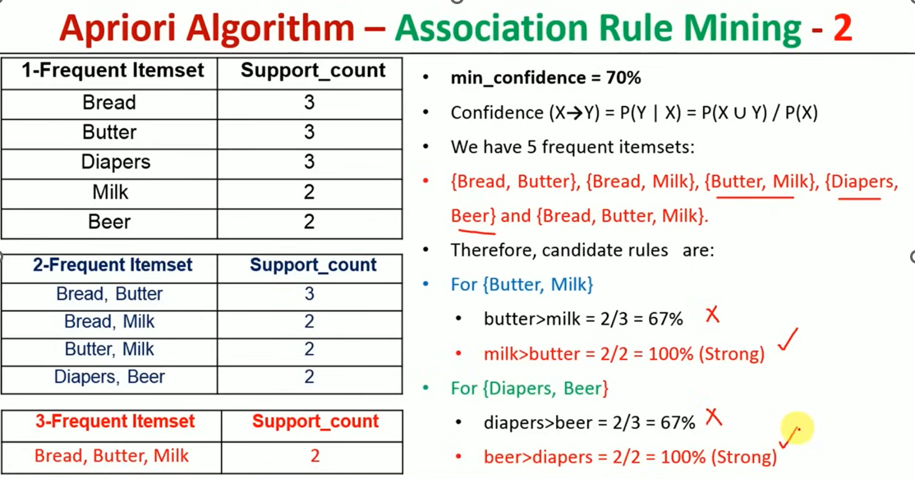

Slide 14
